Slide 1
Babies that cry/scream don’t have reflux
Dr Warren Hyer
Consultant Paediatrician
Consultant Paediatric Gastroenterologist

Slide 2
Educational objectives
Screamers
“silent reflux” – is this an internet diagnosis
PPI’s – probably no role in infants < 1 year

Slide 3
No vomit = no reflux
No vomit = no reflux
Silent reflux is fake news

Slide 4
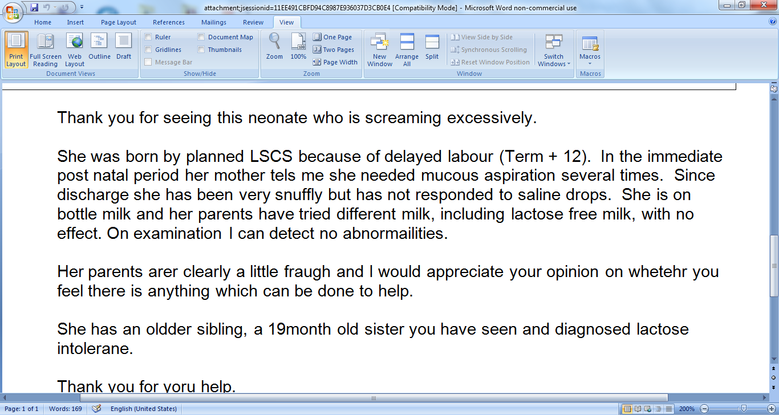

Slide 5
What would you do for this child?
Commence anti reflux therapy
Start colief for lactose intolerance
Change formula to a bitter hydrolysate feed and possibly make the feed difficulties worse
Suggest start solids at the very earliest moment and keep going to then
Notes:
5

Slide 6
Surely not all children who cry have reflux or colic?

Slide 8
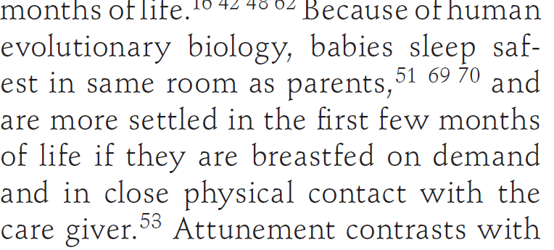

Slide 9
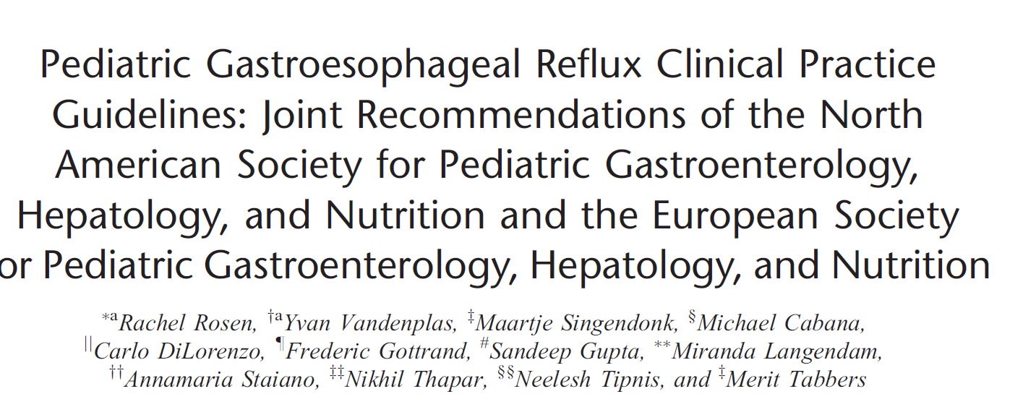
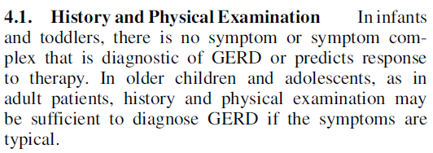
No discriminating aspect to history

Slide 10
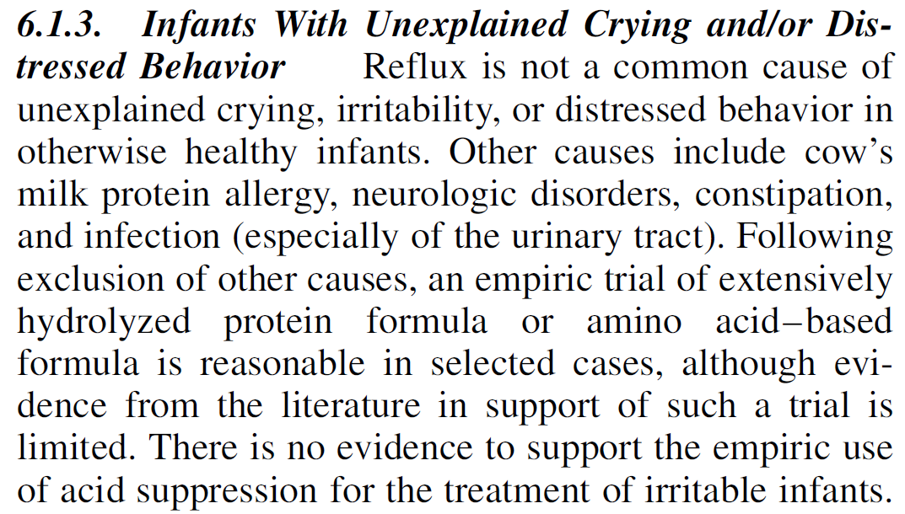
Screaming ≠ reflux

Slide 11
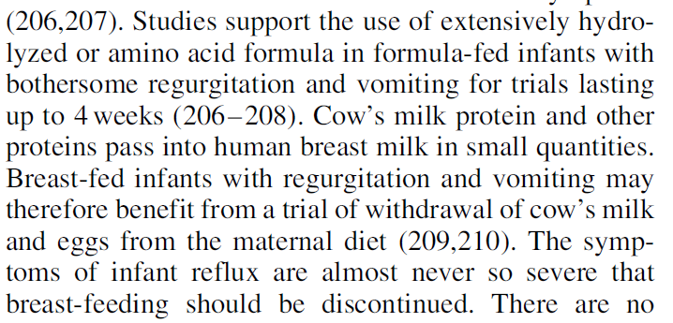
There is a role for change in formula
Trial of withdrawal of cows milk from mothers diet

Slide 12
No discriminating aspect to history

Slide 13
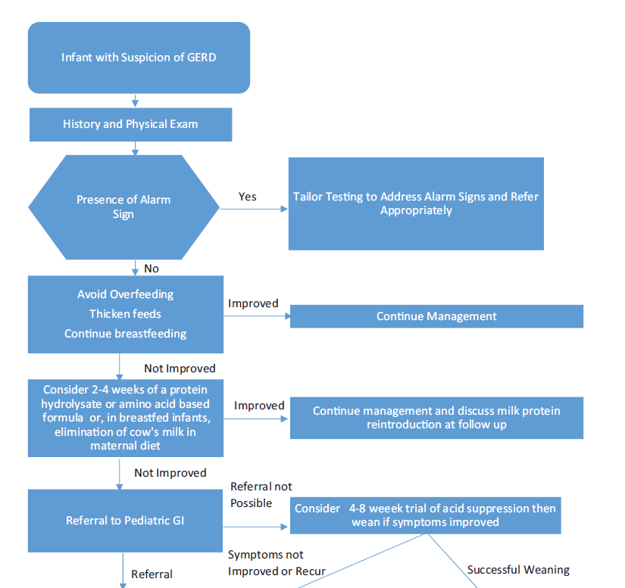

Slide 14
Cows milk formulae
Allergic
Cheap
Partially hydrolysed
Soy not an option
Questionable effectiveness
Elemental
Unpalatable
Expensive
Whey hydrolysate
Caesin hydrolysate
Palatable but allergic
First line for food allergy
First line if breast feeding
tastes nice
e.g. Pepti
e.g. nutramigen
e.g.neocate
Nutramigen Puramino
Similac alimentum
NAN HA
Nestle
Alfaamino
Althera

Slide 15
Evidence does not support use of domperidone

Slide 16
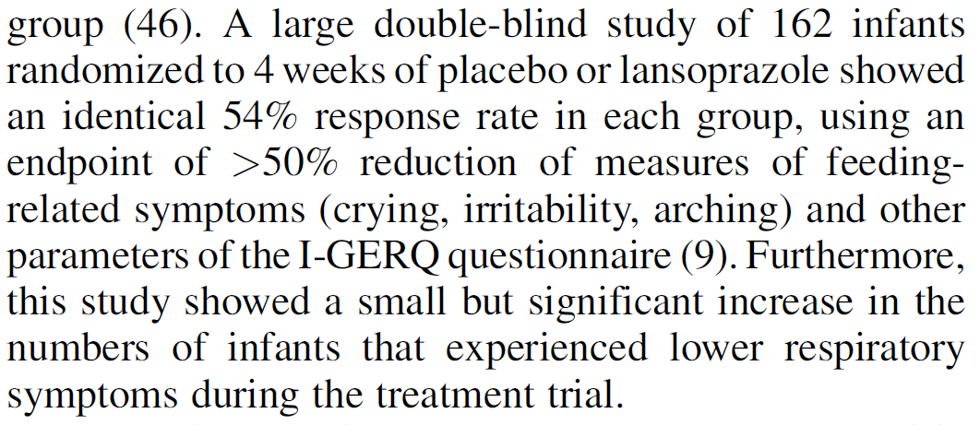
Lack of evidence for PPI in infantile agitation

Slide 19
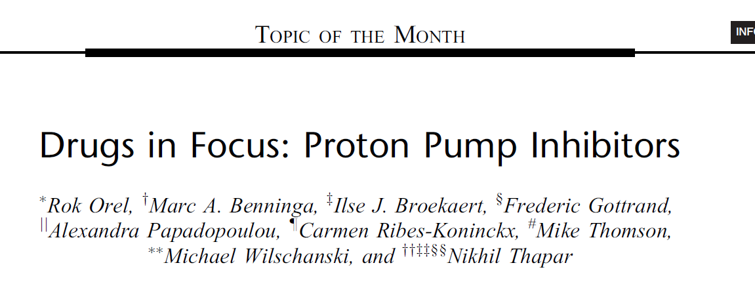
PPIs are among the most commonly prescribed drugs in infants and children with the last decades witnessing a dramatic rise in their utilization
Although PPIs are clearly effective when used appropriately and have been regarded as safe drugs, there is growing evidence, albeit largely from adult studies regarding their potential adverse effects. It is clear that many of these are also relevant to pediatrics
Gut microbiota
Gut defence
Allergy
Absorption of minerals and vitamins

Slide 20
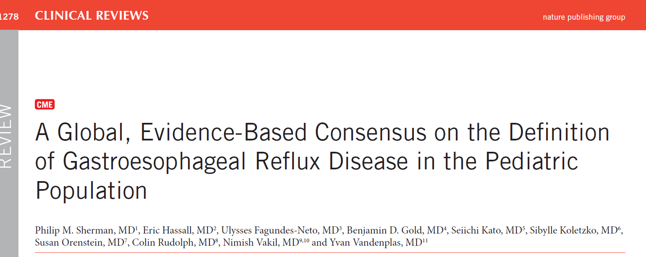
No distinguishable symptoms for GOR versus GORD in infants
Vomting does not predict GORD
Pain and fussing does not predict GORD in infants

Slide 21
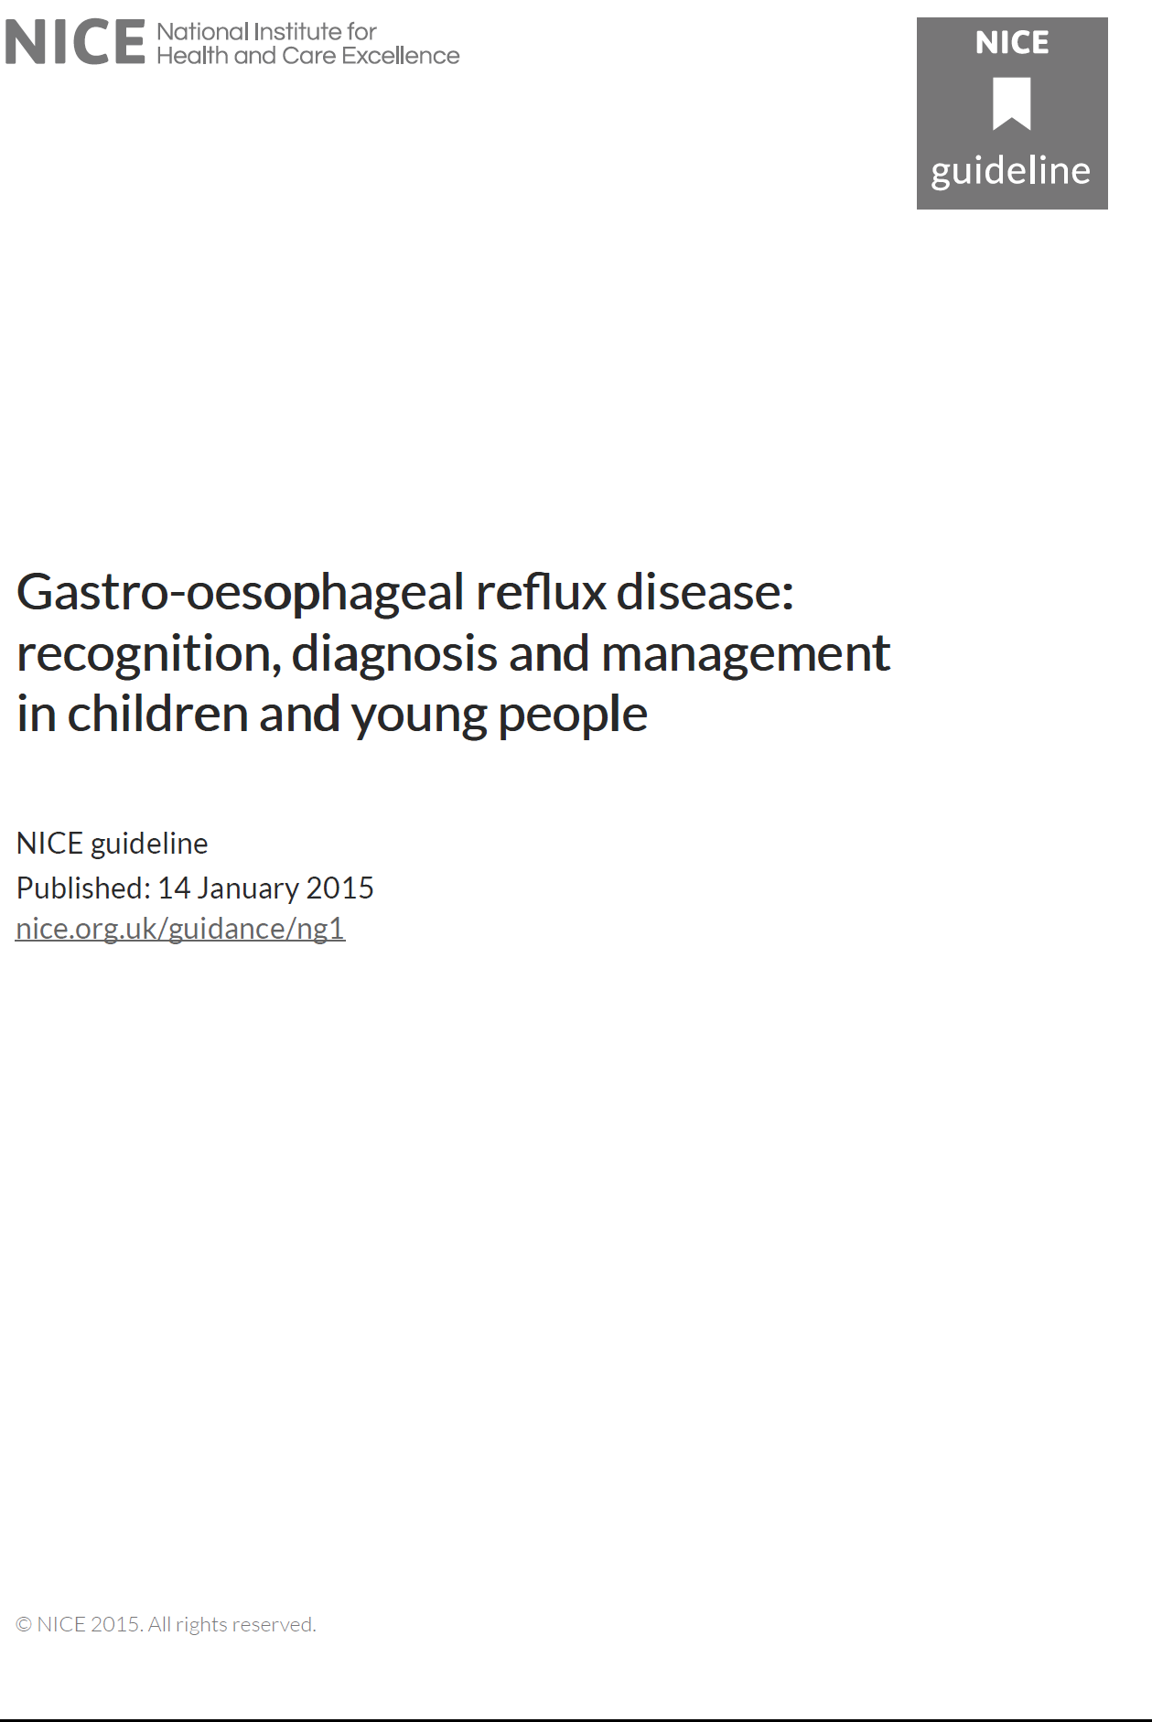
Avoid PPI’s in young children with distress
Avoid prokinetics – they don’t work and can harm
So can PPI’s

Slide 22
Multicenter, double-blind, randomized, placebo-controlled trial assessing the efficacy and safety of proton pump inhibitor lansoprazole in infants with symptoms of gastroesophageal reflux disease J Paediatr 2019
162 patients with symptoms of GORD
81 given lansoprazole
81 given placebo
44 improved
44 improved

Slide 23
IgE mediated immediate reaction
Food allergy like urticaria or anaphylaxis
Non IgE mediated – delayed manifestation
eczema
Allergic colitis
Oral allergy syndrome
Infantile colic
GORD
Allergic dysmotility
Enteropathy

Slide 24
Inaccuracy of histories
“Unlike any other area in medicine, the history of adverse reaction to food is more often incorrect than it is correct”
Bock, 1998
Professor Paediatrics, Colorada
Notes:
9 studies between 1980 to 1994, a range of 40-60% reproducibility of history and DBPCFC - this was in a highly selected group and therefore how after are they reproduced in the general population by paediatricians

Slide 25
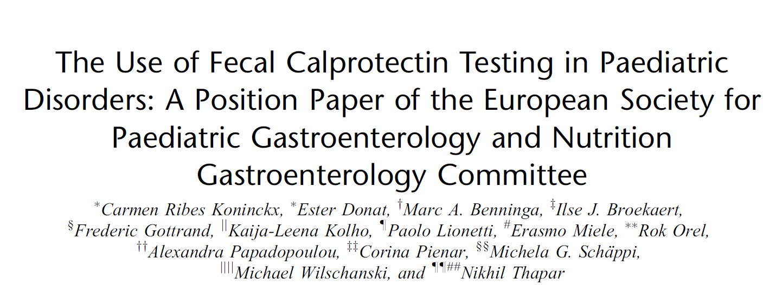

Slide 26
Cows milk formulae
Allergic
Cheap
Partially hydrolysed
Soy not an option
Questionable effectiveness
Elemental
Unpalatable
Expensive
Whey hydrolysate
Caesin hydrolysate
Palatable but allergic
First line for food allergy
First line if breast feeding
tastes nice
e.g. Pepti
e.g. nutramigen
e.g.neocate
Nutramigen Puramino
Similac alimentum
NAN HA
Nestle
Alfaamino
Nestle alfare

Slide 27
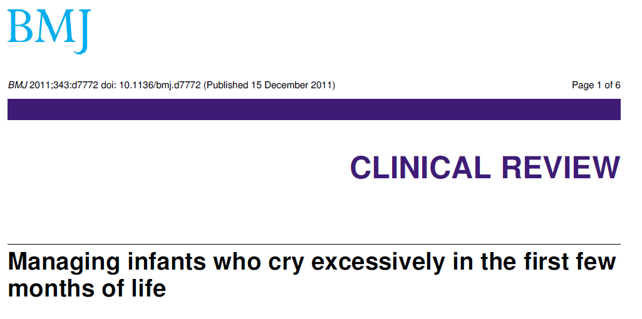

Slide 29
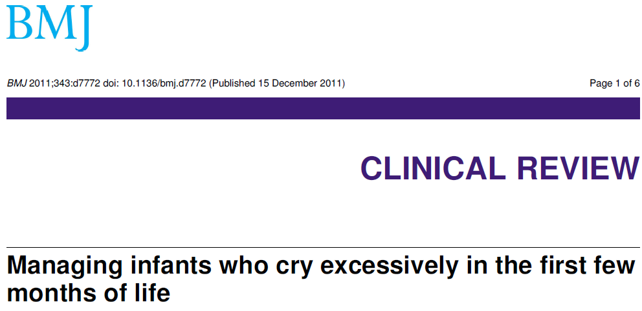
Differential diagnosis cited in this paper:
Maternal reasons - expectations
Feeding problems
Functional lactose overload
Allergy
Infection

Slide 30
IgE mediated immediate reaction
Food allergy like urticaria or anaphylaxis
Non IgE mediated – delayed manifestation
eczema
Allergic colitis
Oral allergy syndrome
Infantile colic
GORD
Allergic dysmotility
Enteropathy

Slide 31
Learning points in GOR and infantile colic
Avoid treating reflux when there is little evidence to support the use of anti reflux therapy in infantile colic
Realise that infantile colic is not the same as reflux

Slide 32
No vomit = no reflux
No vomit = no reflux
Silent reflux is fake news

